Slide 1

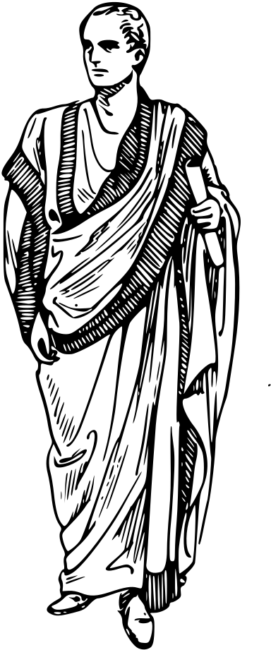


UNIT: 2
Writing Biographies

Slide 2



What all do you notice in these books?
Note down your observations (in journals).

Slide 3


Slide 4
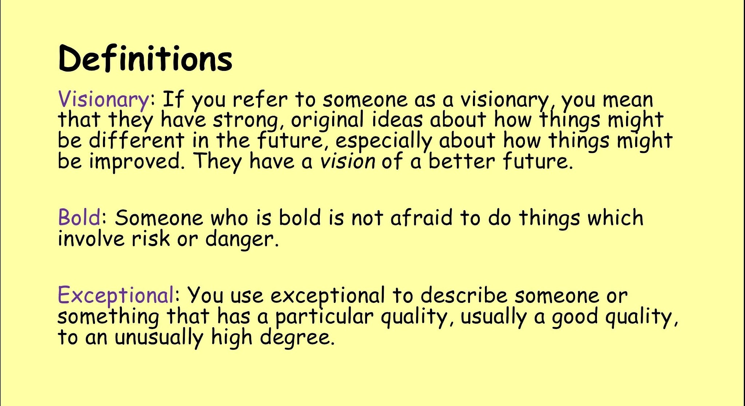

Slide 5
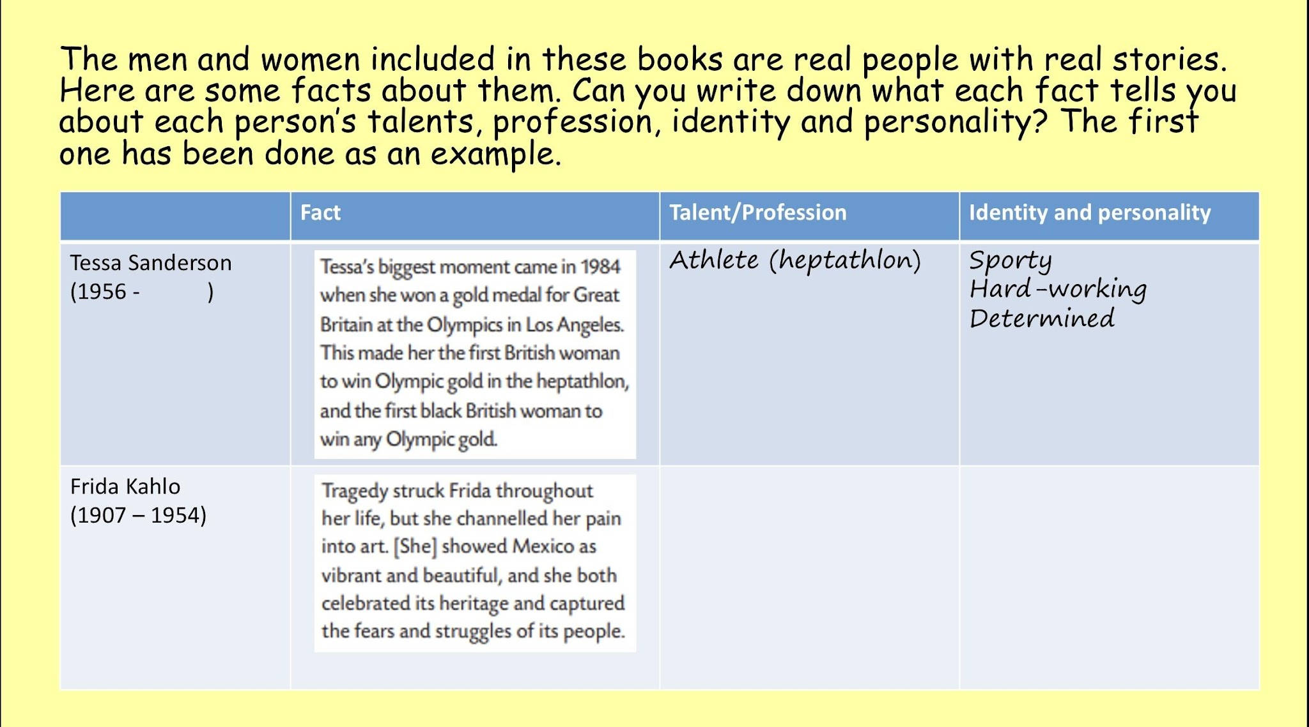

Slide 6


Slide 7
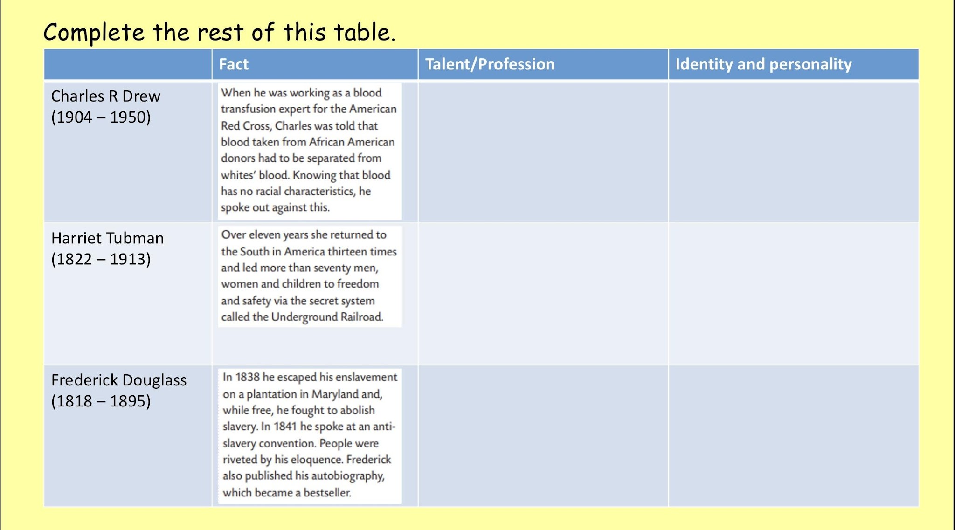

Slide 8
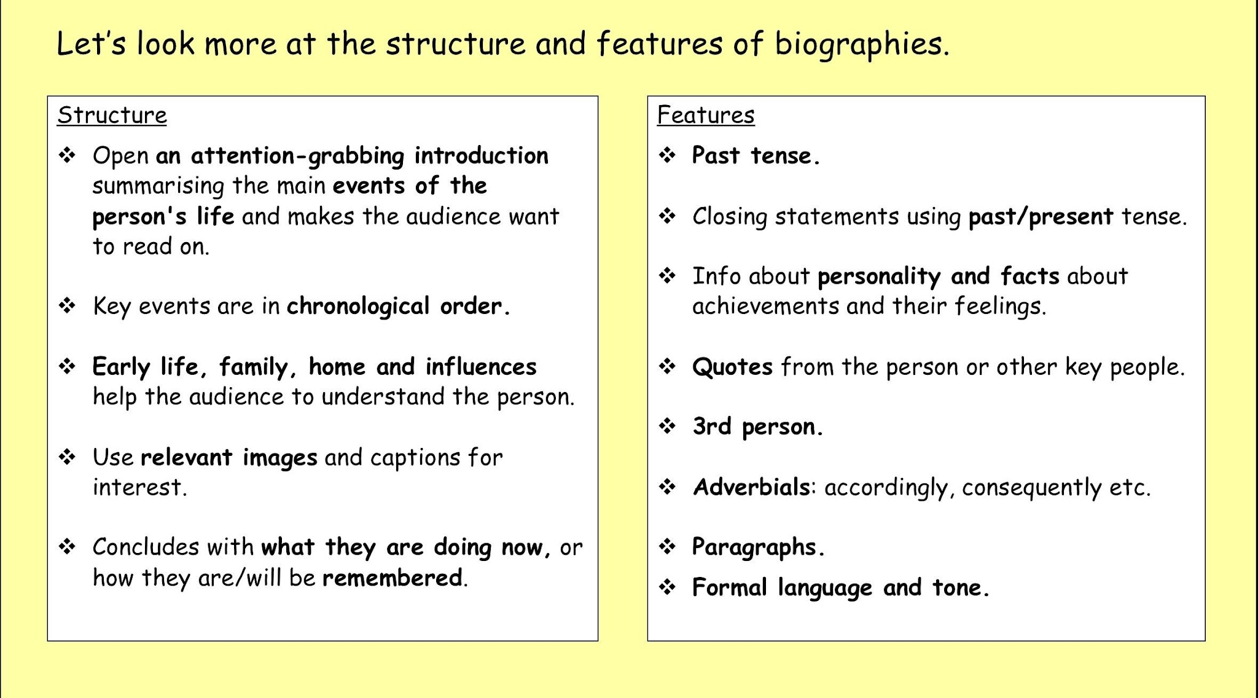

Slide 9
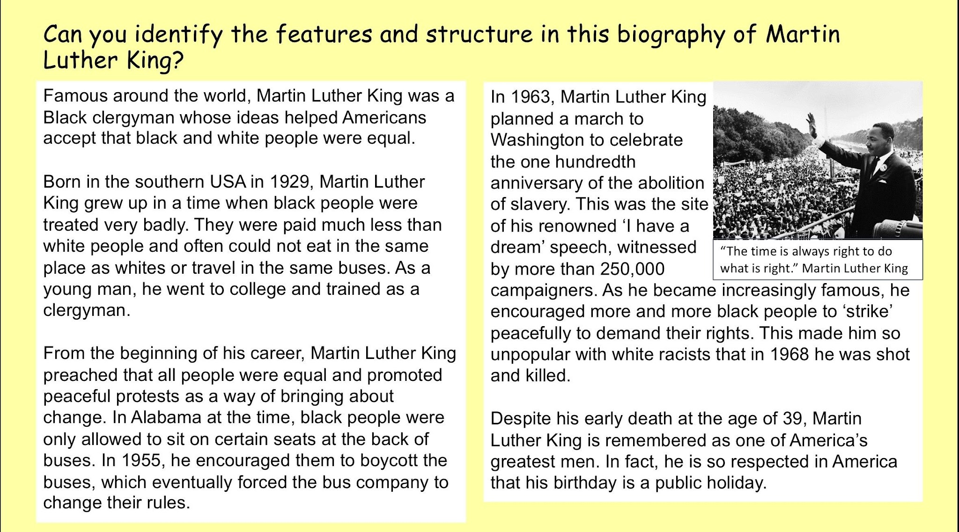

Slide 10
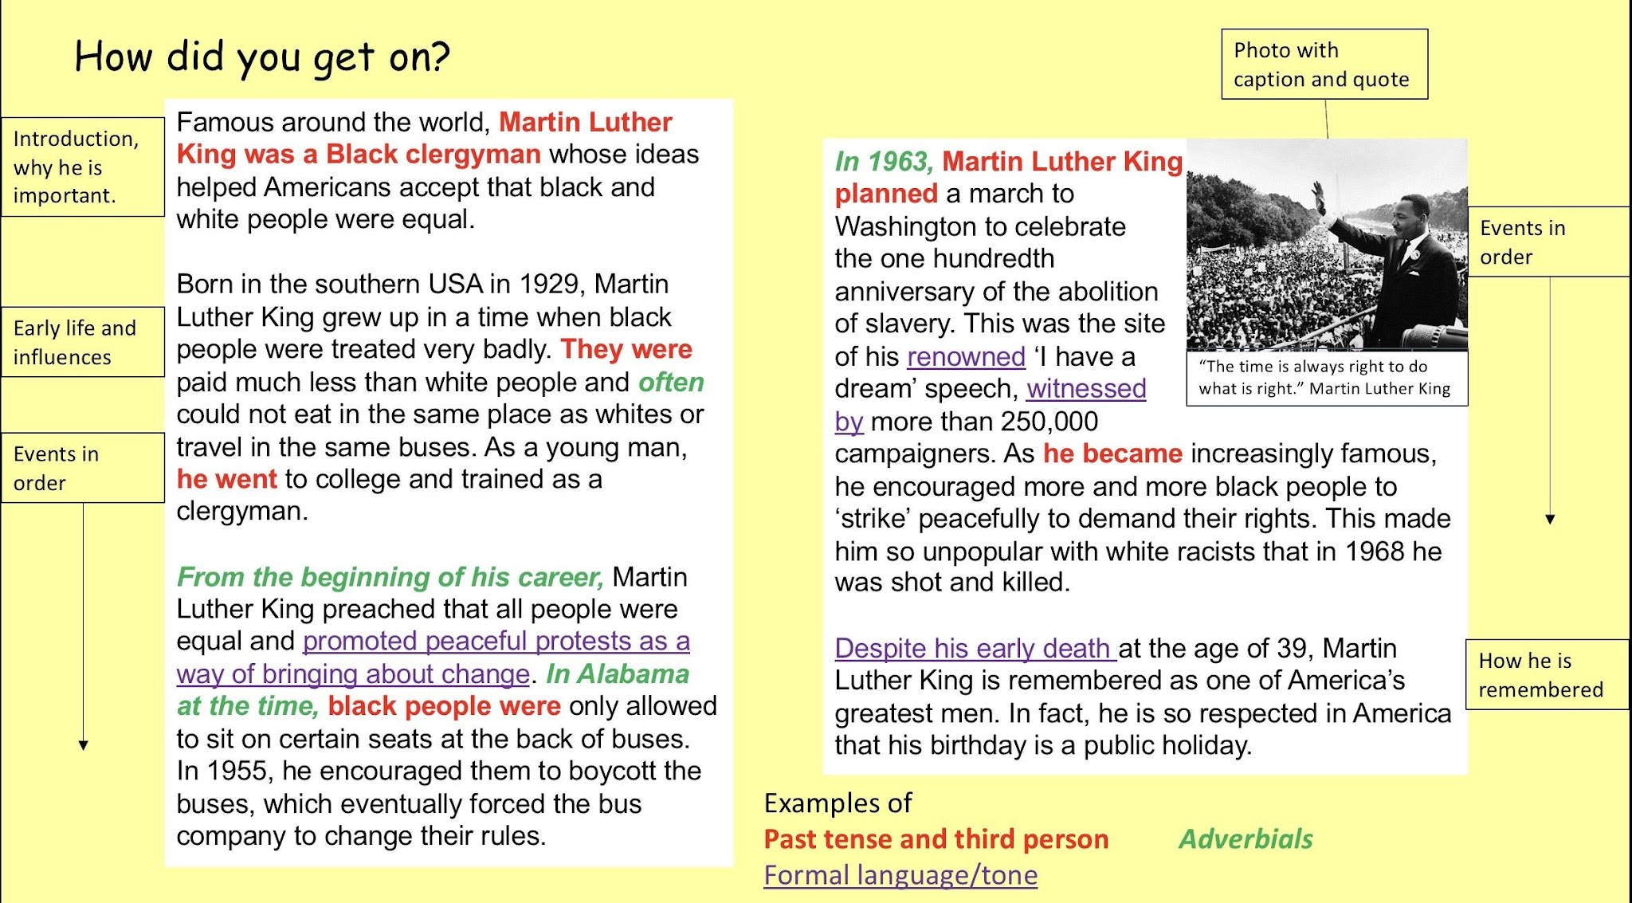

Slide 11



LEARNING EXTENSION
Biography
Copy the table, slides 6-8, from the PPT (on drive) and complete it.
Complete the task given on slide 13 in your journal.

Slide 12


Slide 13



THANK YOU

